Slide 1
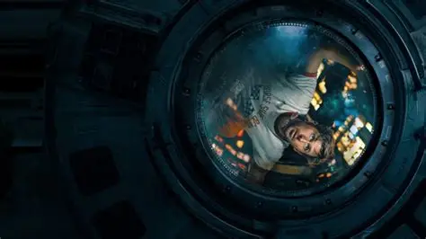
Project About Virtual and Augmented Reality / 2026
/
ORBITAL
RESCUE
Project Goal
This project aims to develop a first-person immersive VR experience for students and general users interested in space exploration and virtual reality. Players take on the role of an astronaut on a space station. They can grab floating objects, move along handrails, clear space debris and repair power connectors. Since physical weightlessness cannot be achieved, users experience the weightless environment through the visual motion rules of objects and specific interactions within the VR world. The project also explores how visual cues and physical interactions shape people's perception of weightless environments.
轨道救援：空间站维修与太空垃圾回收
Orbital Rescue: Space Station Maintenance and Space Debris Removal
本项目旨在为对太空探索和虚拟现实感兴趣的学生及普通用户开发一款第一人称沉浸式 VR 体验。玩家将扮演一名空间站宇航员，通过抓取漂浮物体、沿扶手移动、清理太空垃圾和维修电源接口，在难以实现身体层面失重感受的情况下，通过VR世界视觉层面物体运动规律和特定交互方式体验失重环境，并探索视觉线索与物理交互如何影响人对失重环境的感知。
Duration：2026/10/12 — 2026/12/15 · 64 days
UNITY XR
First-person
5–10 min
ddl 12/15
PROJECT CHARTER • GAMEPLAY • SCENES • TECH • ASSETS

Slide 2
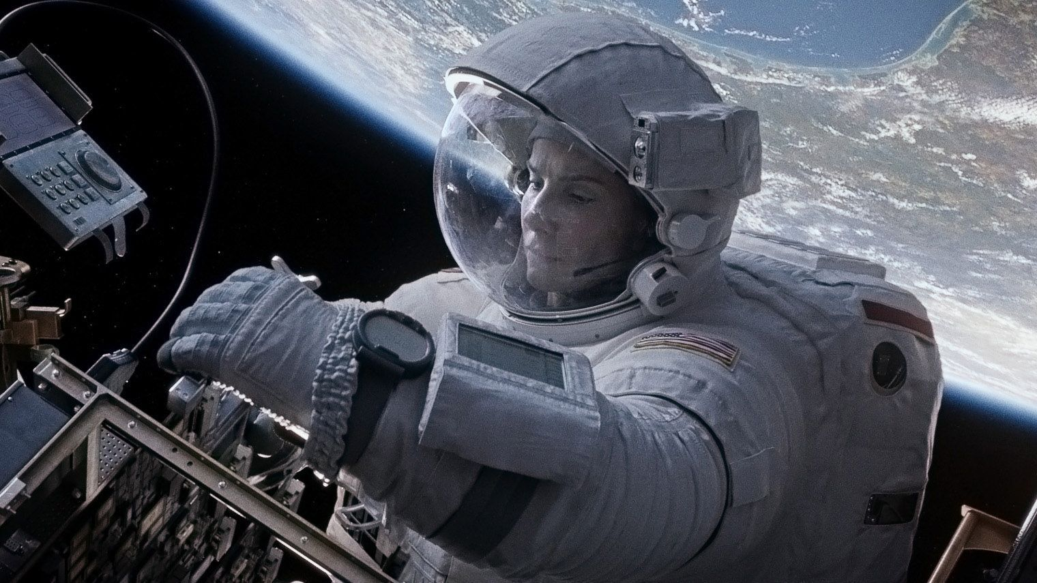
Project Overview | 项目概要
ORBITAL RESCUE is a first-person VR experience developed in Unity. Players take on the role of an astronaut repairing a space station after debris causes an equipment malfunction. They must enter the exterior maintenance area, collect floating debris, and reconnect a damaged power interface.
Using VR controllers, players can grab, move, and release objects, as well as move along handrails outside the station. An Earth backdrop, floating objects, ambient sounds, and equipment feedback create an immersive space environment.
Designed for students and general users interested in space exploration and VR interaction, the experience lasts approximately five to ten minutes. Players complete a mission briefing, spacewalk, debris collection, equipment repair, and mission conclusion. The project explores how visual cues and interactive feedback can communicate weightlessness while keeping the experience intuitive and achievable within the course deadline.
SCENE LAYOUT / 场景布局
01Interior Mission Area
02 Airlock(气闸舱）
Tools / Mission terminal
Hatch / Exit
03 Exterior Maintenance Area
Solar panels / Debris / Repair interface
Background: Earth / Stars / Sunlight

Slide 3
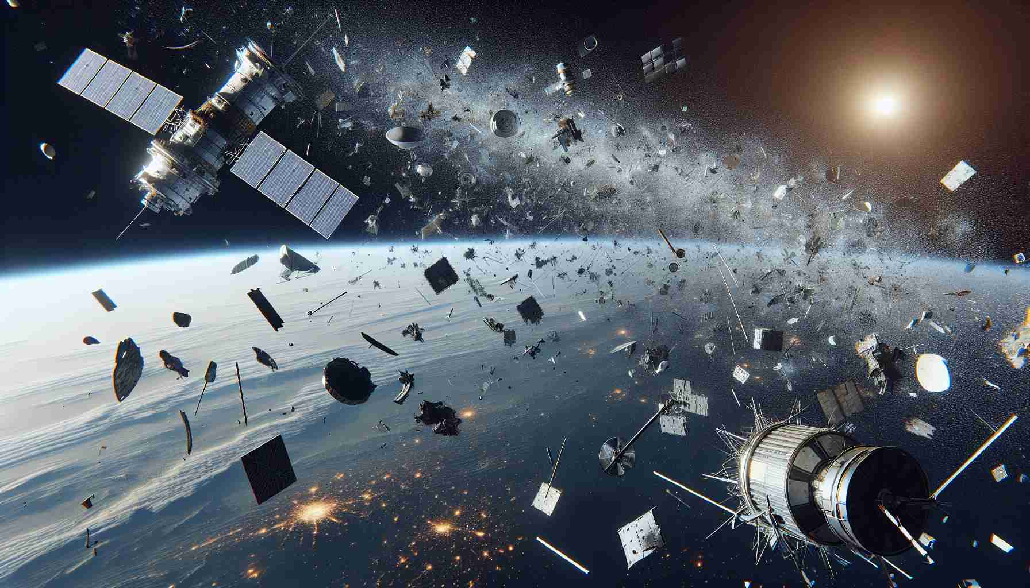
Challenges&Feedbacks | 挑战与不足
Standard VR headsets cannot eliminate the gravitational forces experienced by the player's body.
Therefore, the goal is not to make the player's body physically weightless, but to use “visual cues and interactions” to create the illusion of moving and manipulating objects in a weightless environment.
This can be divided into three key aspects:
Visual Representation
Locomotion
Physics-Based Interaction
普通 VR 头显无法真正消除玩家身体感受到的重力?!
因此，目标不是让玩家的身体真的失重，而是通过视觉和交互，让玩家相信自己正在失重环境中移动和操作物体,可拆解为三部分：
视觉表现
移动方式
物理交互

